Slide 1
Behavioral Health Information Technologies and Standards (BHITS) II
Omnibus Care Plan
Care Manager User Guide
Developed by FEI Systems for SAMHSA BHITS September 2018

Slide 2
Contents
Introduction
Part 1: The Patients Panel
Part 2: To Do/Upcoming Tasks Panel
Part 3: Upcoming Appointments Tab
Part 5: Managing the Patient’s Detail Page
Part 5.1: Managing the Patient’s Tasks/To Do Panel
Part 5.2: Managing Patient’s Care Teams Panel
Part 5.3: Managing Patient’s Appointments
Part 5.4: Managing Patient’s Communications
Part 6: Managing Patient’s Coverage
Part 7: Viewing and Creating Consents

Slide 3

Introduction: Omnibus Care Premise
Patient-centered care revolves around effective and efficient care coordination across care providers, patient engagement, social connectedness, and facilitating the patients’ treatment beyond episodic or chronic treatment.
Today, the healthcare environment is fragmented and ineffectual in providing 360⁰ whole-patient care with the mix of private and public insurers and self-pay with a large number of no-pay patients.
SAMHSA is devoted to the care and treatment of behavioral health patients. New models of paying for care are being developed and initiated with the objective to reduce the cost of healthcare.

Slide 4
About the Omnibus Care Plan (OCP)
A patient-centric, standards-based, goal-driven treatment plan
Application through which the patient and his or her care team can communicate
Authoritative source for care planning
Synthesize, reconcile, and de-conflict patients’ data
Monitor patients’ data and monitor processes across health care institution boundaries
Real-time integrated view of an individual care plan
Includes structured and narrative information

Slide 5
Omnibus Care Plan Modules
Organization Administration Module–Adding and managing organization details, contact personnel, locations and activity definitions
Practitioners Module–Adding and managing practitioner details, practitioner roles and organization association
Patients Module–Adding and managing patient details, patient’s care teams (which include members across organizations, related persons and other patients) and patient’s insurance/benefits details
OCP Access Module–Register users to OCP and manage user access
Appointments and Scheduling Module–Creating appointments, appointment actions (accept, tentative, decline), calendar view, appointments panel and importing organization Outlook calendar into OCP
Tasks and To-Do Module–Creating, managing and updating patient-related tasks (based on organization defined activity definitions) and patient related To-Dos
Communications Module–Logging patient communications and associate communications with appointments, tasks and To-Dos
Care Planning Module–Creating and managing care plan in Quippe Clinical Lens
Screeners and Assessment Module–Patient screeners and assessments through bhworks CUBS assessment tool
Consent Management Module–Creating and managing patient’s consents through Consent2Share
SMART-on-FHIR Apps Management Module–Consent2Share, Quippe Clinical Lens & Designer, bhworks CUBS Assessment

Slide 6


Omnibus Care Plan Functional Overview
Administrative
Program, Services, Locations
Patient Enrollment
Practitioners, Organizations
Episode of Care
Care Coordination
Caseload Mgmt. Dashboard
Program Mgmt.
Screener/ Assessment
Scored screening and assessments (MA Assessment, PHQ9, PHQ4, etc.)
BH-Works Comprehensive Assessment
Care Planning
SOAP/Visit Notes
Outreach/ Activity Management
Smart Notes
Dynamic Care Plan Summary
Scheduling/ Appointment
New Appointments
Encounter Management
Goals and Interventions based on Outcomes/scores
Patient Consent
Computable Scores/sub-scores (LOINC)
Enrollee/ Consumer Dashboard
Standards-based Data Shared Among Applications
5

Slide 7
Omnibus Care Plan Portal and Users
OCP Admin
Onboarding of organizations to OCP and adding practitioners to OCP
Managing roles/users in UAA and Helpdesk/Troubleshooting
Org Admin
Managing organization locations, healthcare services, activity definitions
Associating practitioners to organization/location and assigning roles
Care Manager
Manage patient information, care teams, and assign care coordinators
Patient consents
Care Coordinator
Tasks, To Do, Appointments, Communication, Assessments
Care Coordination activities and care plan management
Patient
Other Possible Functional Roles
Similar Care coordination activities for Benefits specialist, Front Office, Health Assistant, and so on
Patient information, Care Team
Business Function Role
Capabilities to be Demonstrated
Appointments, Communication, Consents

Slide 8
About the Omnibus Care Plan User Guides
The Omnibus Care Plan User Guides will provide information about how different users navigate the Omnibus Care Plan, and more:
Omnibus Care Plan Administrator User Guide
Organization Administrator User Guide
Care Manager User Guide
Care Coordinator User Guide
Using SMART-on-FHIR Applications

Slide 9
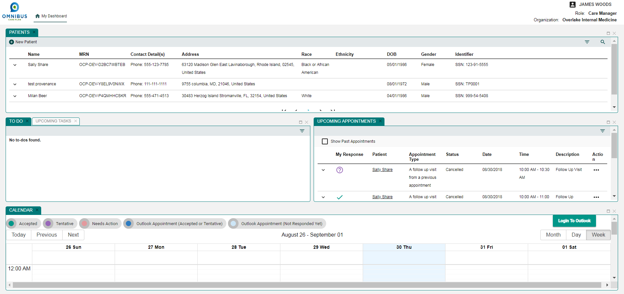
Role of the OCP Care Manager
Manage patient information
Manage care teams
Assign care coordinators
Manage patient consents

Slide 10
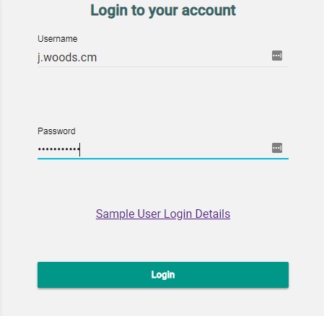
OCP Care Manager Login Page
Login using Care Manager credentials

Slide 11
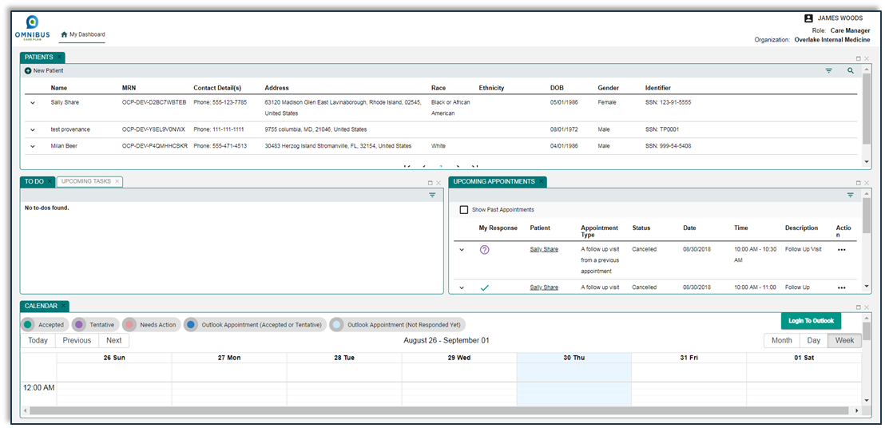
OCP Care Coordinator Dashboard

Slide 12
The OCP Care Manager Dashboard
The Care Manager Dashboard has four panels:
Patients
To Do/ Upcoming Tasks
Upcoming Appointments
Calendar

Slide 13
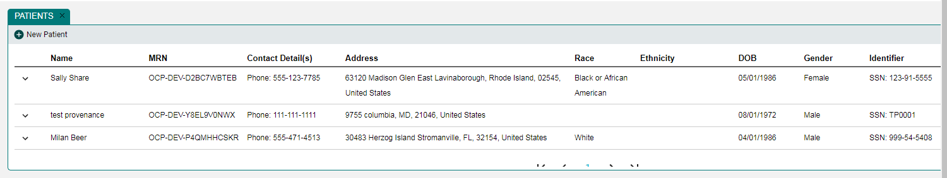
Part 1: The Patients Panel

Slide 14
Patients Panel: View Details
Click chevron to view patient quick view

Slide 15
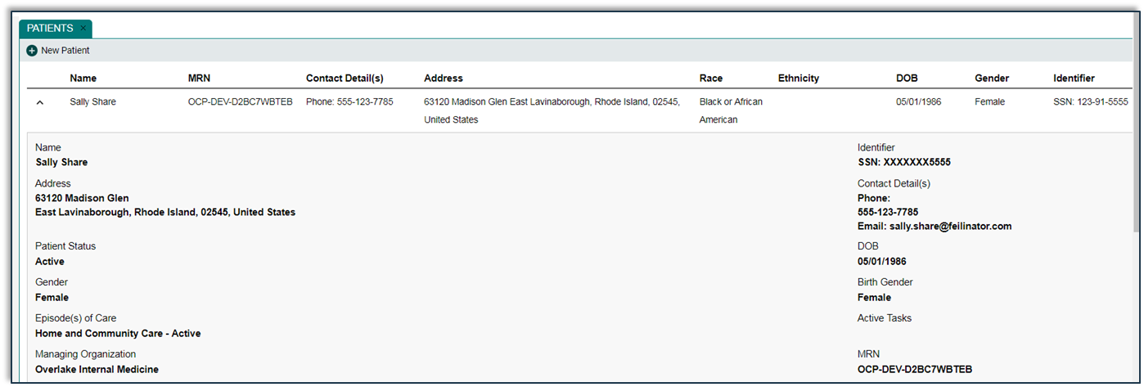
Patients Panel: Quick View
Click Chevron to view the patient quick view

Slide 16
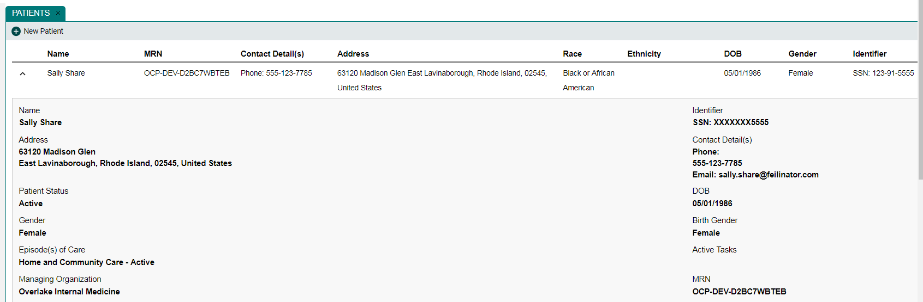
Patients Panel: Patient Quick View

Slide 17
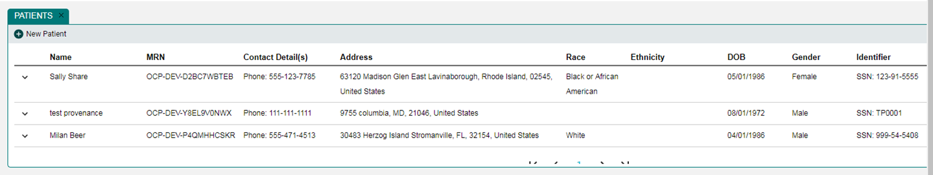
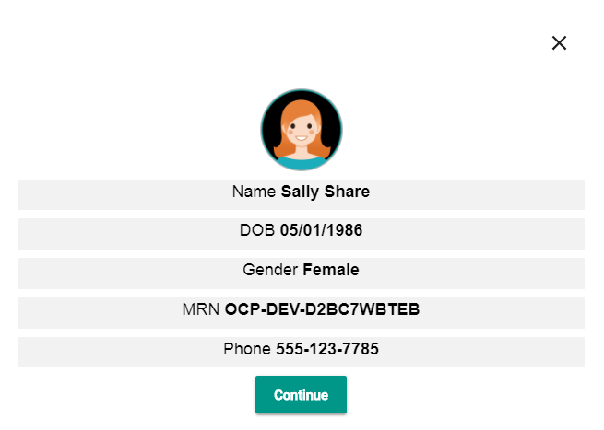
Patients Panel: Patient Card
Click name for Patient Details Page.
Patient Card opens.

Slide 18
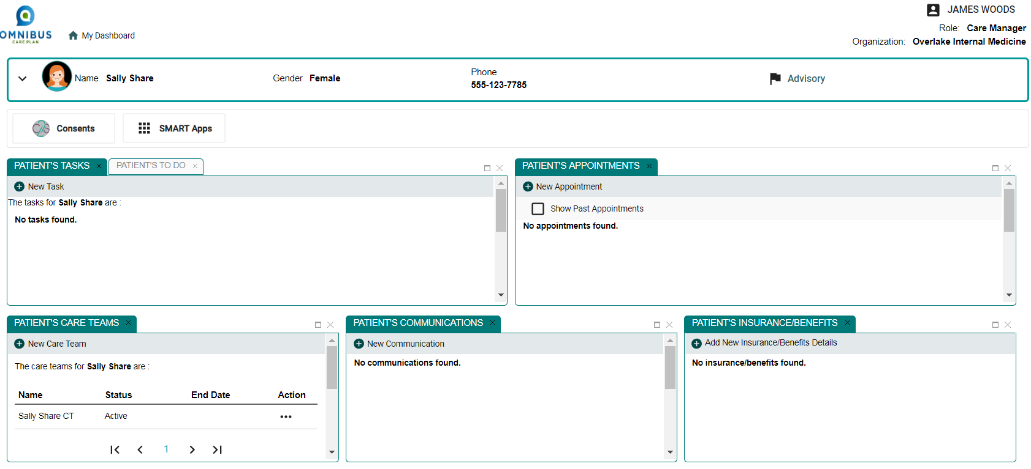
Patients Panel: Patient’s Details Page
Clicking Continue button opens the Patient’s Details Page.

Slide 19
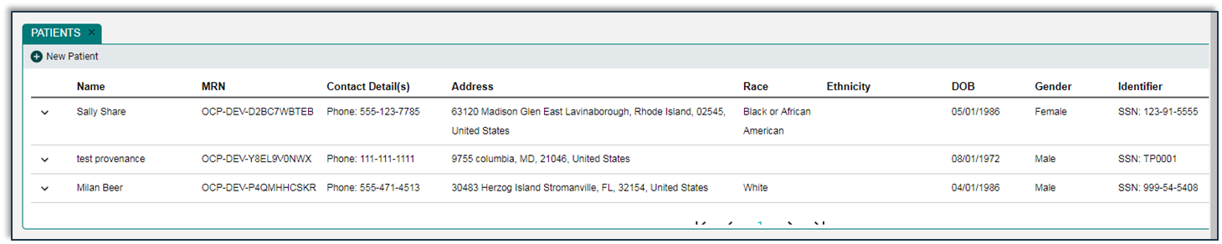
Patients Panel: Add New Patient
Back to Patient Panel
Click New Patient icon to begin process of adding a new patient

Slide 20
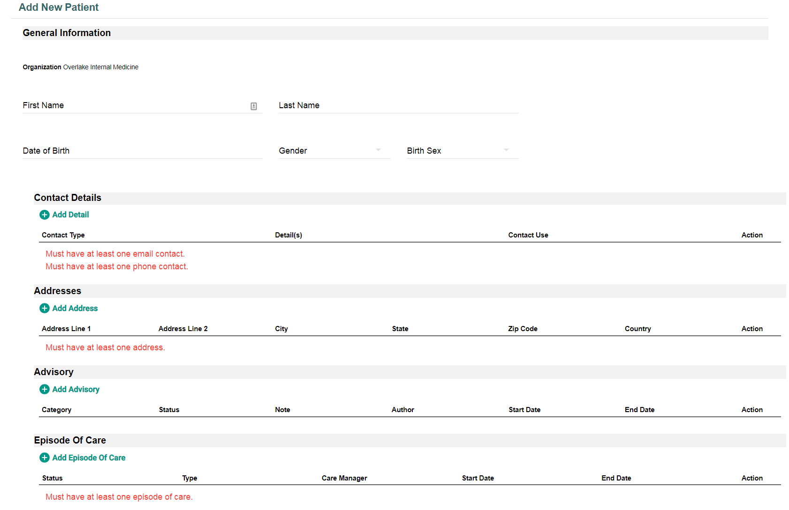
Patients Panel: Add New Patient Page (Top)
Enter fields to add a new patient.

Slide 21
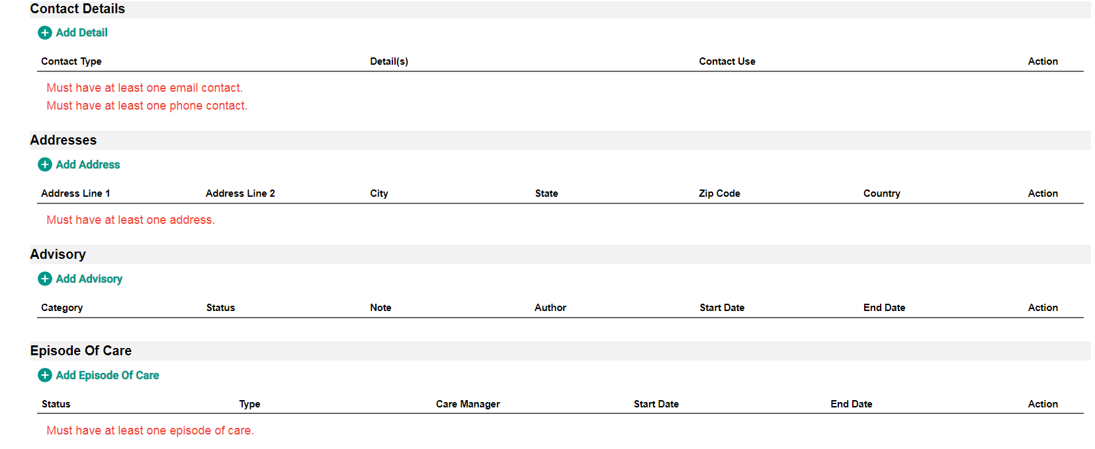
Patients Panel: Add New Patient Page (Bottom)
Continue entering fields to add a new patient.

Slide 22
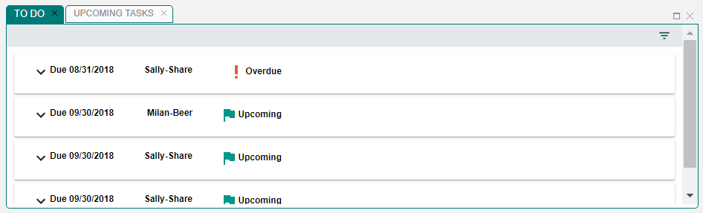
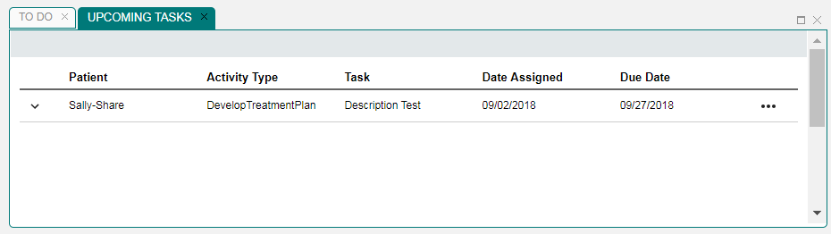
Part 2: To Do/Upcoming Tasks Panel
To Do and Upcoming Tasks Tabs Toggle

Slide 23
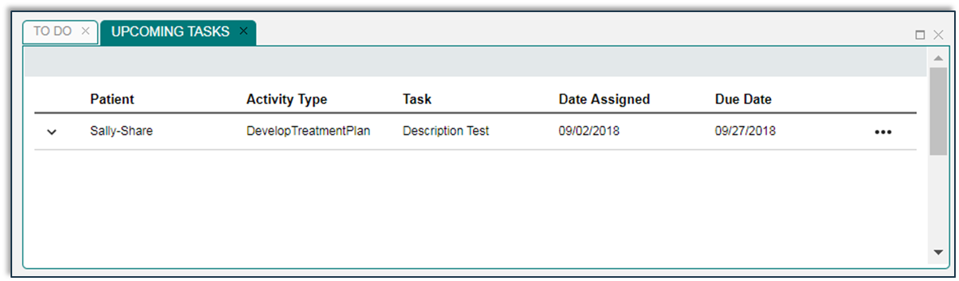
Upcoming Tasks Tab
Click chevron to open quick view

Slide 24
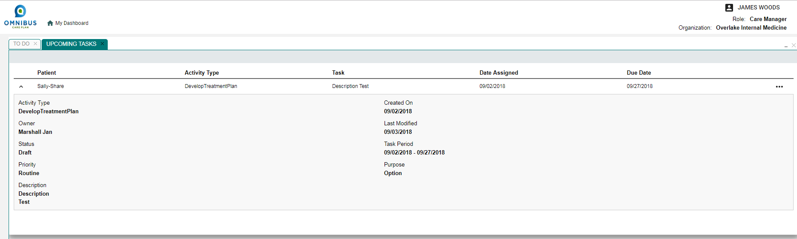
Upcoming Tasks: Quick View Page Opens

Slide 25
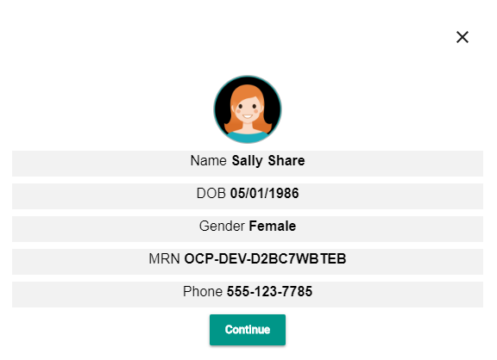
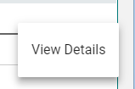
Upcoming Tasks: View Details or Edit
Click ellipses, click View Details, Patient Card Opens, Click Continue.

Slide 26
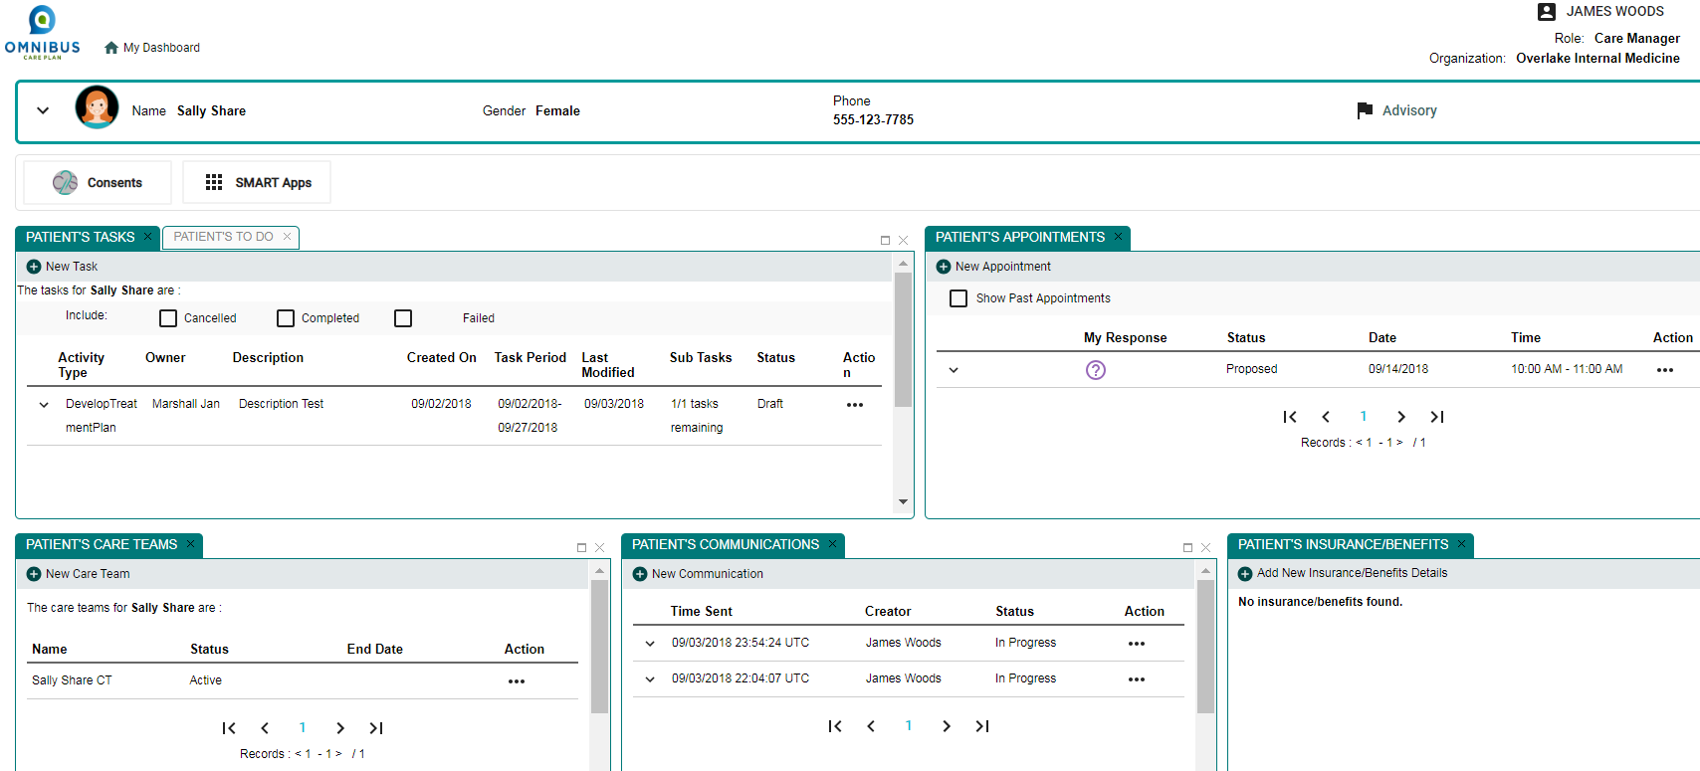
Upcoming Tasks: Patient Details Page Opens

Slide 27
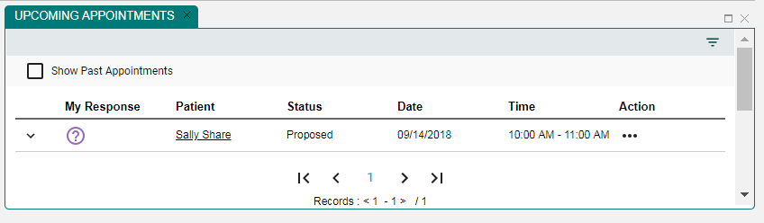
Part 3: Upcoming Appointments Tab

Slide 28
Upcoming Appointments Tab: Quick View
Click chevron for quick view

Slide 29
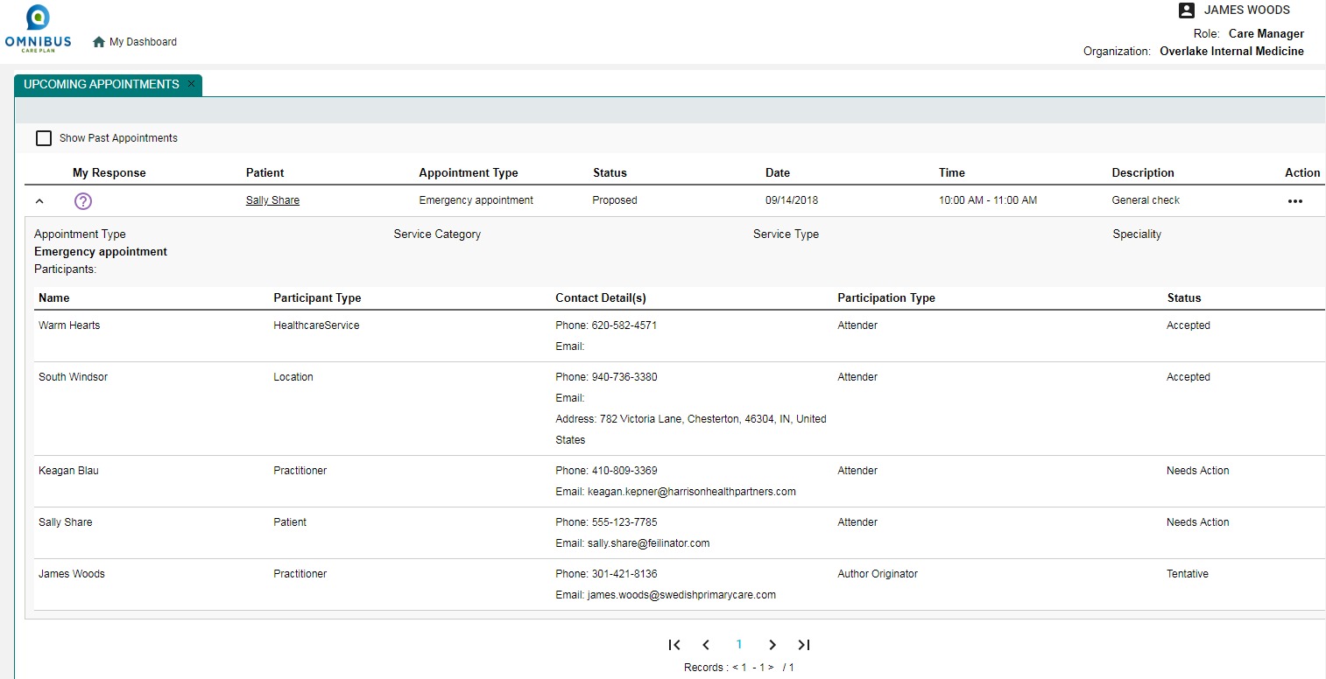
Upcoming Appointments Tab: Quick View Opens
Click chevron for quick view

Slide 30
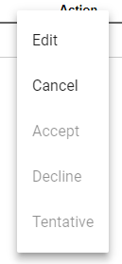
Upcoming Appointments Tab: Edit or Cancel
Click ellipses to editor cancel

Slide 31
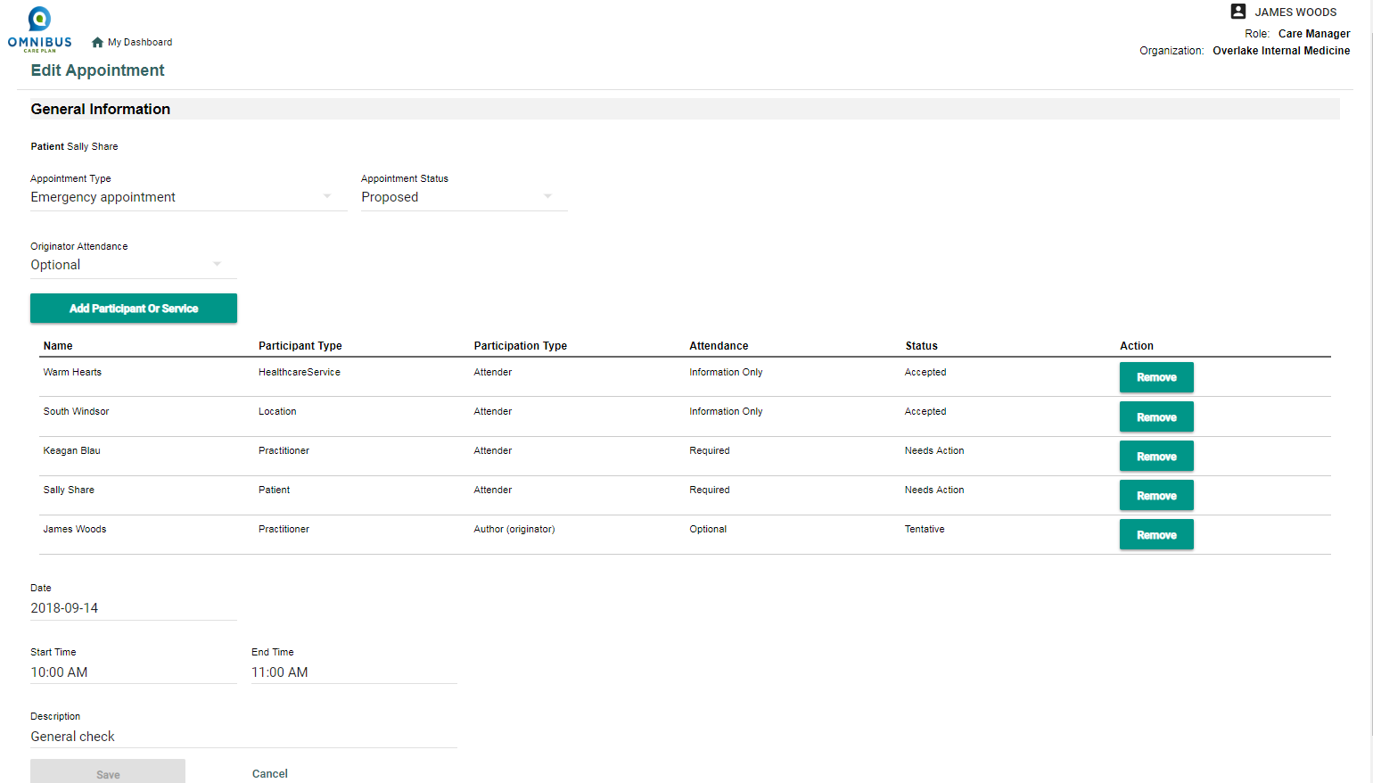
Upcoming Appointments Tab: Edit Appointment Pg.

Slide 32
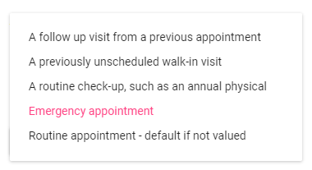
Upcoming Appointments Tab: Edit Appt. Type

Slide 33
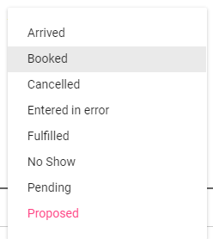
Upcoming Appointments Tab: Edit Appt. Type

Slide 34
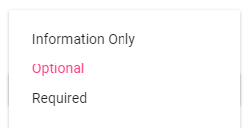
Upcoming Appointments Tab: Edit Attendance

Slide 35
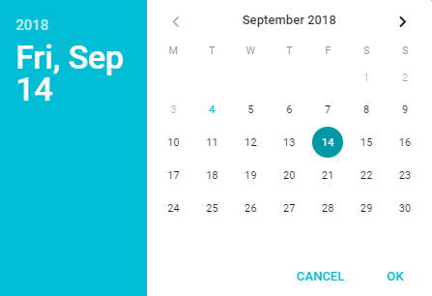
Upcoming Appointments Tab: Edit Attendance

Slide 36
Upcoming Appointments Tab: Edit Times

Slide 37
Upcoming Appointments Tab: Enter Description Text

Slide 38
Upcoming Appointments Tab: Delete Appointments

Slide 39
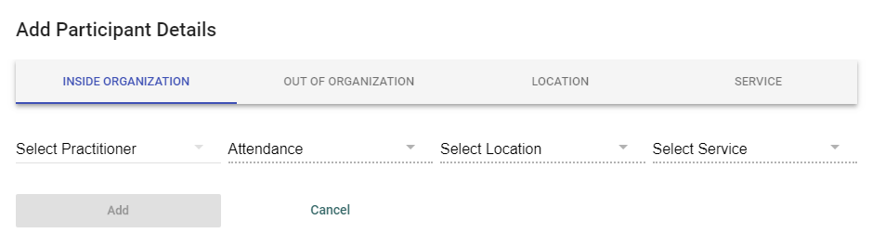
Upcoming Appointments: Add Participant or Service

Slide 40
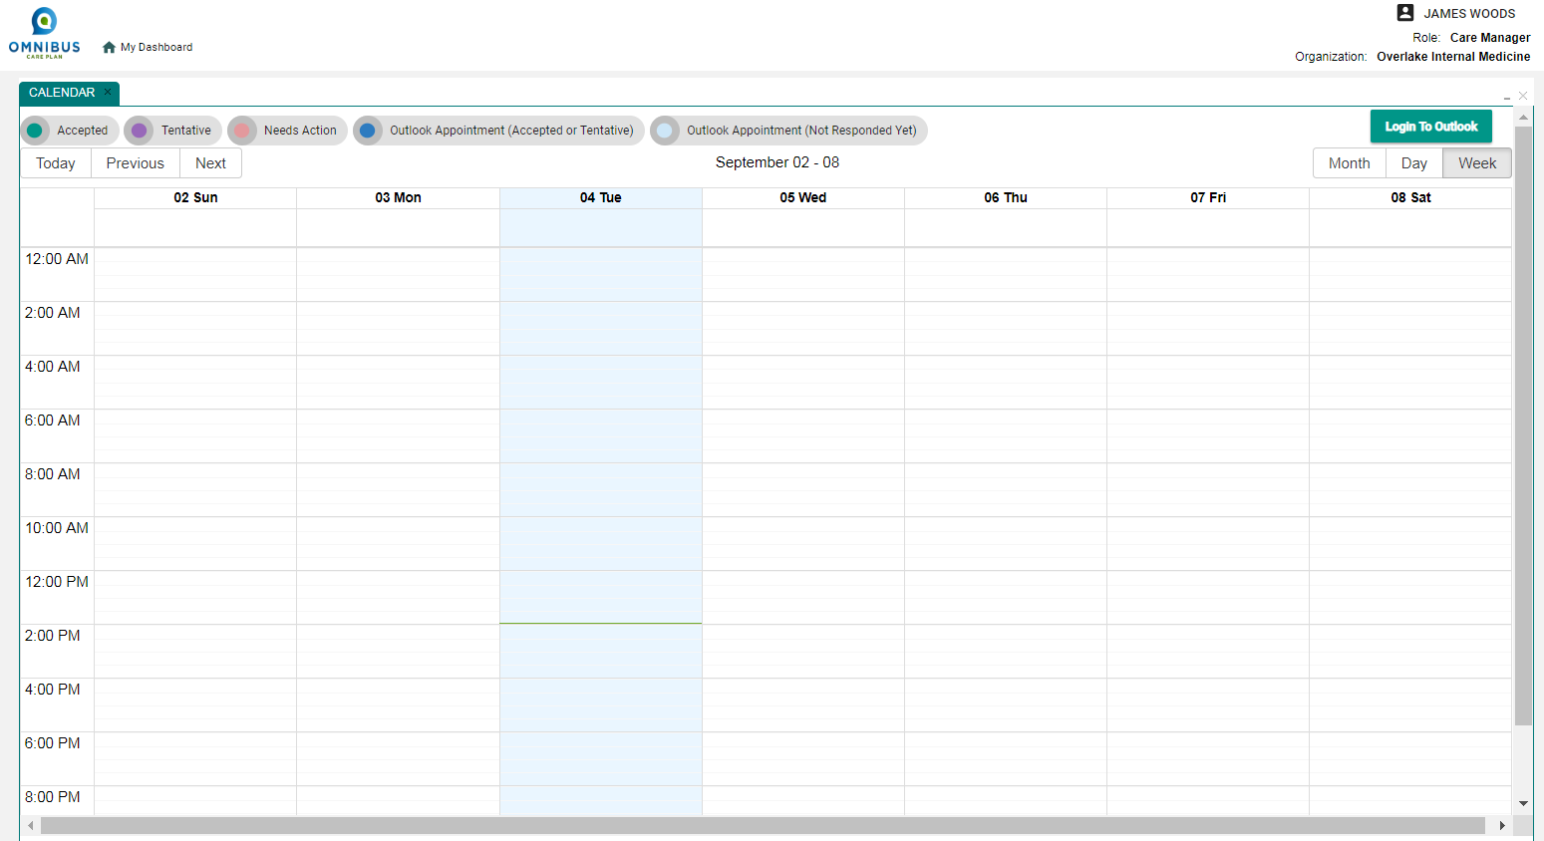
Part 4: The Calendar Panel

Slide 41
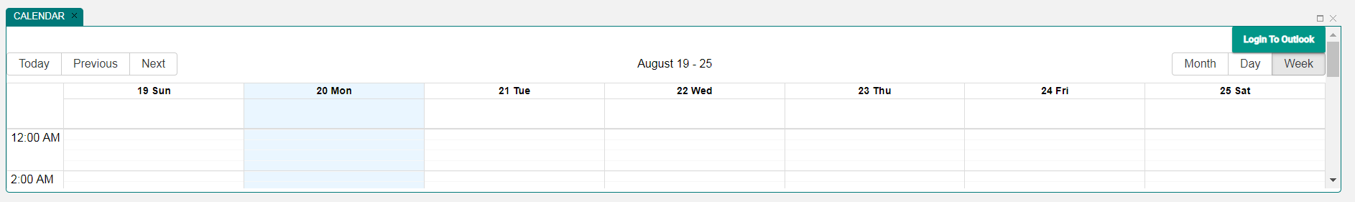
The Calendar Panel
OCP Care Manager can view and modify patients’ calendars with permission
Clicking Expand square will expand the calendar

Slide 42
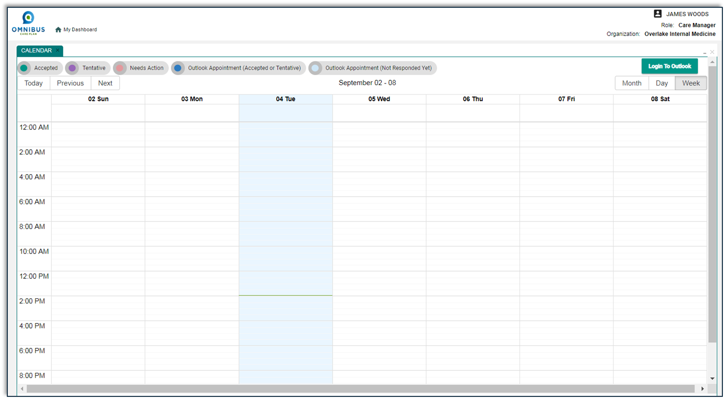
Calendar Panel Expanded View

Slide 43
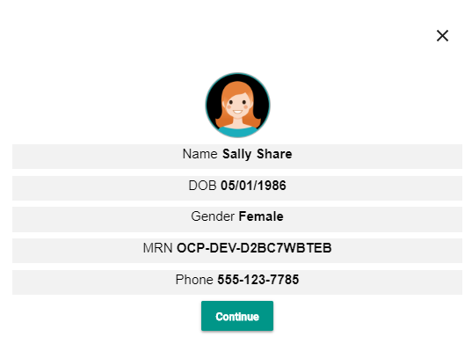
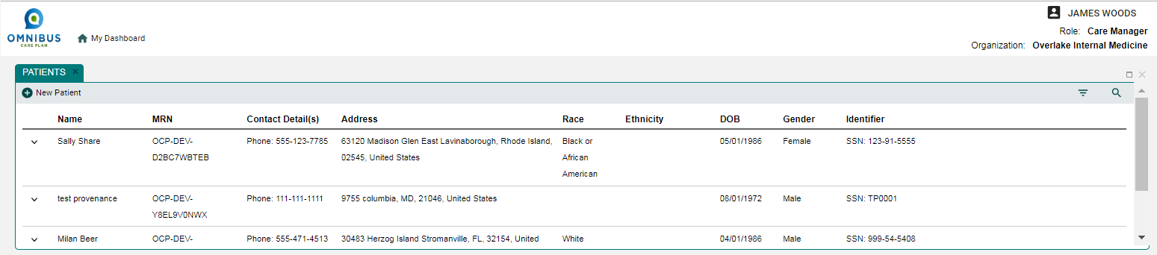
Calendar Panel: Add an Appointment
Go to My Dashboard. Select a patient. Click Continue.

Slide 44
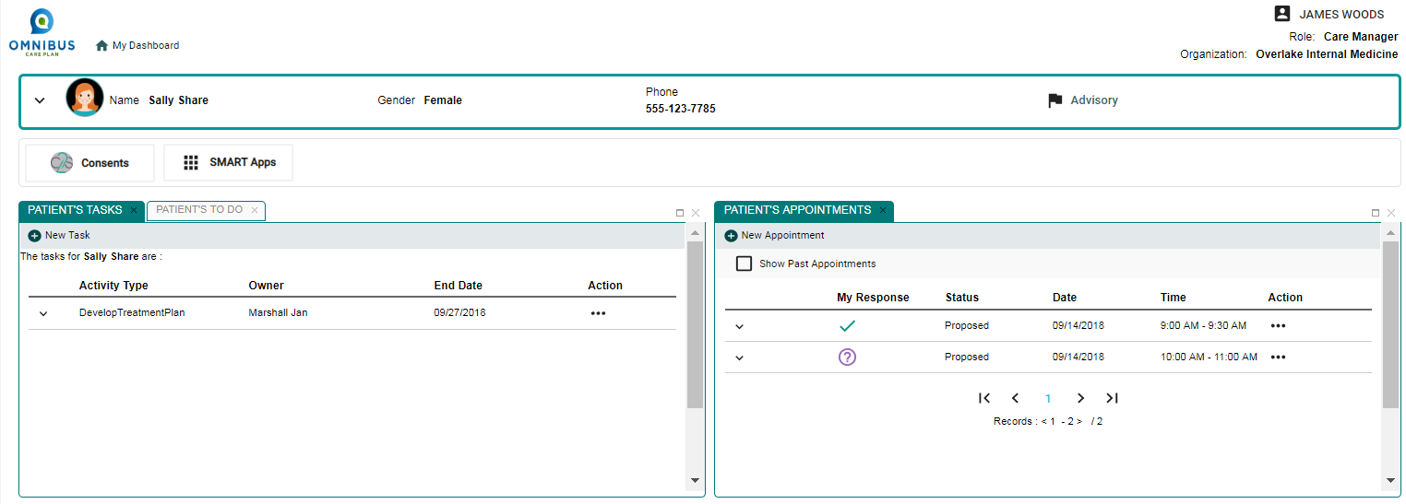
Calendar Panel: Select New Appointment
On Patient Details Page, select New Appointment.

Slide 45
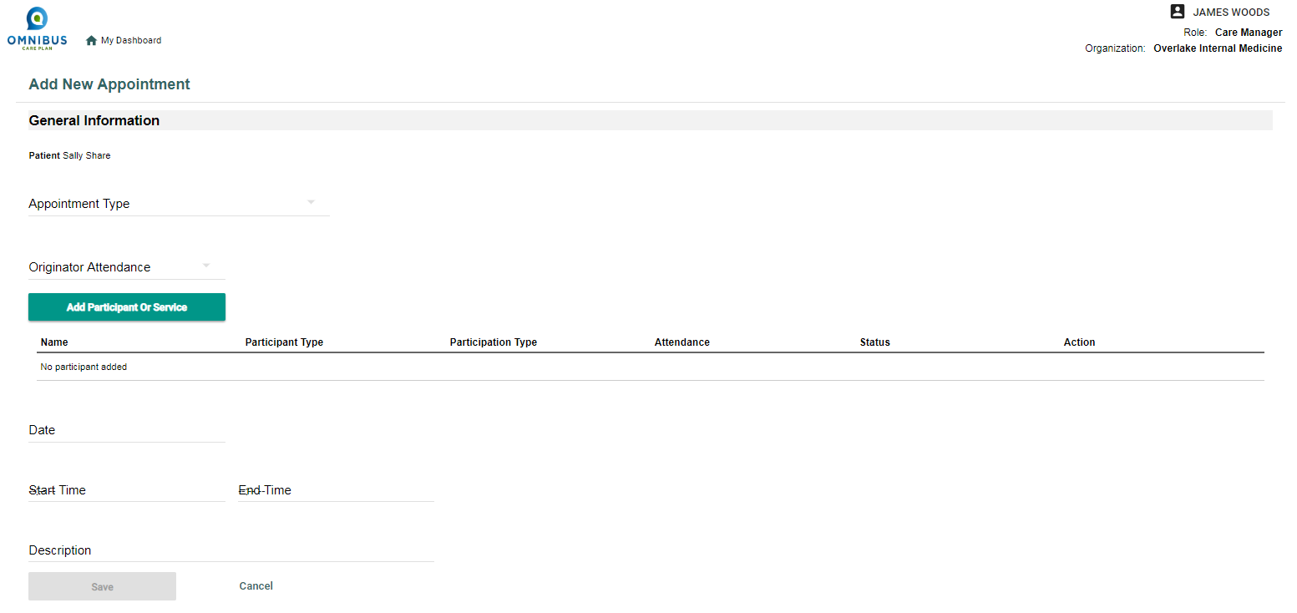
Calendar Panel: Create New Appointment
Add New Appointment Page opens.

Slide 46
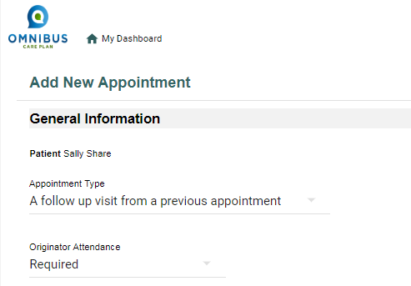
Calendar Panel: Enter Information
First, add Appointment Type and Originator Attendance.

Slide 47
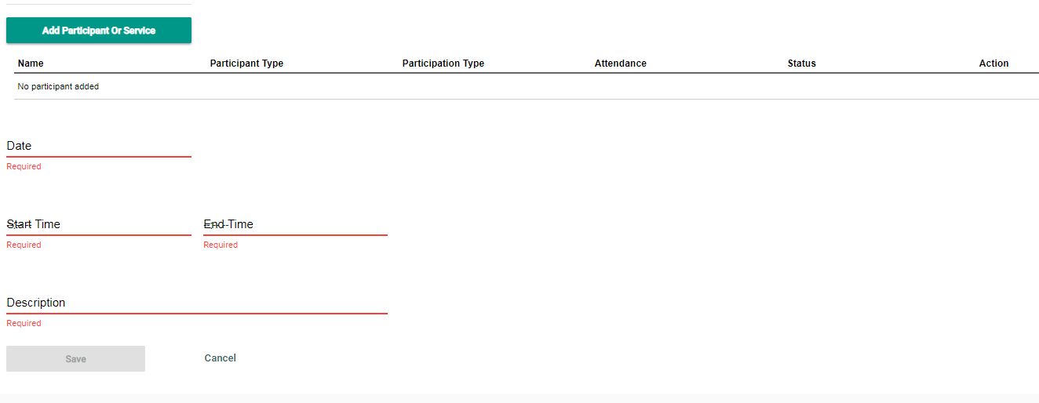
Calendar Panel: Enter Information
Next, click Add Participant or Service button. Add Appointment pop-up opens.

Slide 48
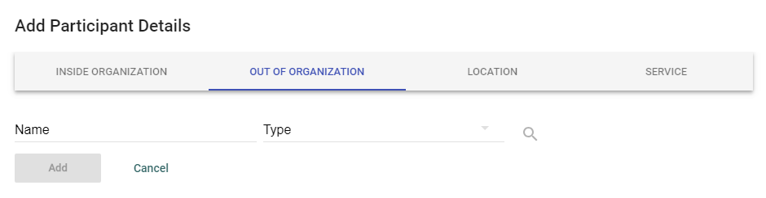
Calendar Panel: Enter Information
Fill out information in the Add Appointment pop-up.

Slide 49
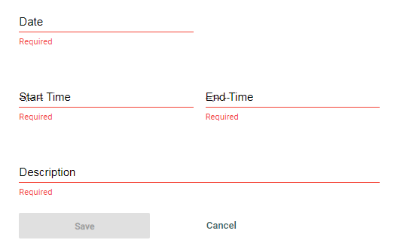
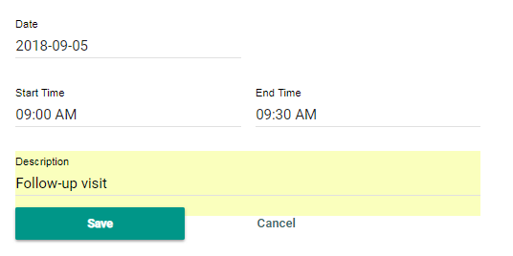
Calendar Panel: Enter Information
Complete information for Date, Time, and Appointment Description. Click Save.

Slide 50
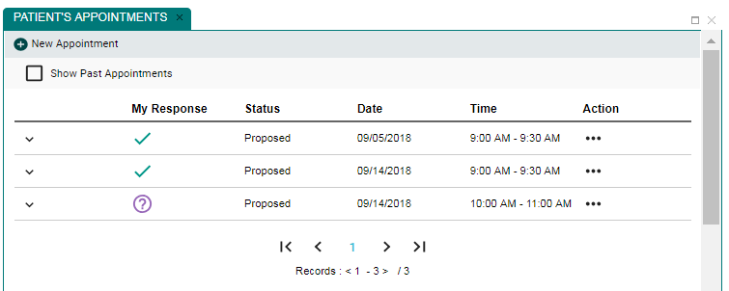
Calendar Panel: Information Now Displays
Information now displays on Patient’s Appointments panel.

Slide 51
Return to Dashboard & Expand Calendar

Slide 52
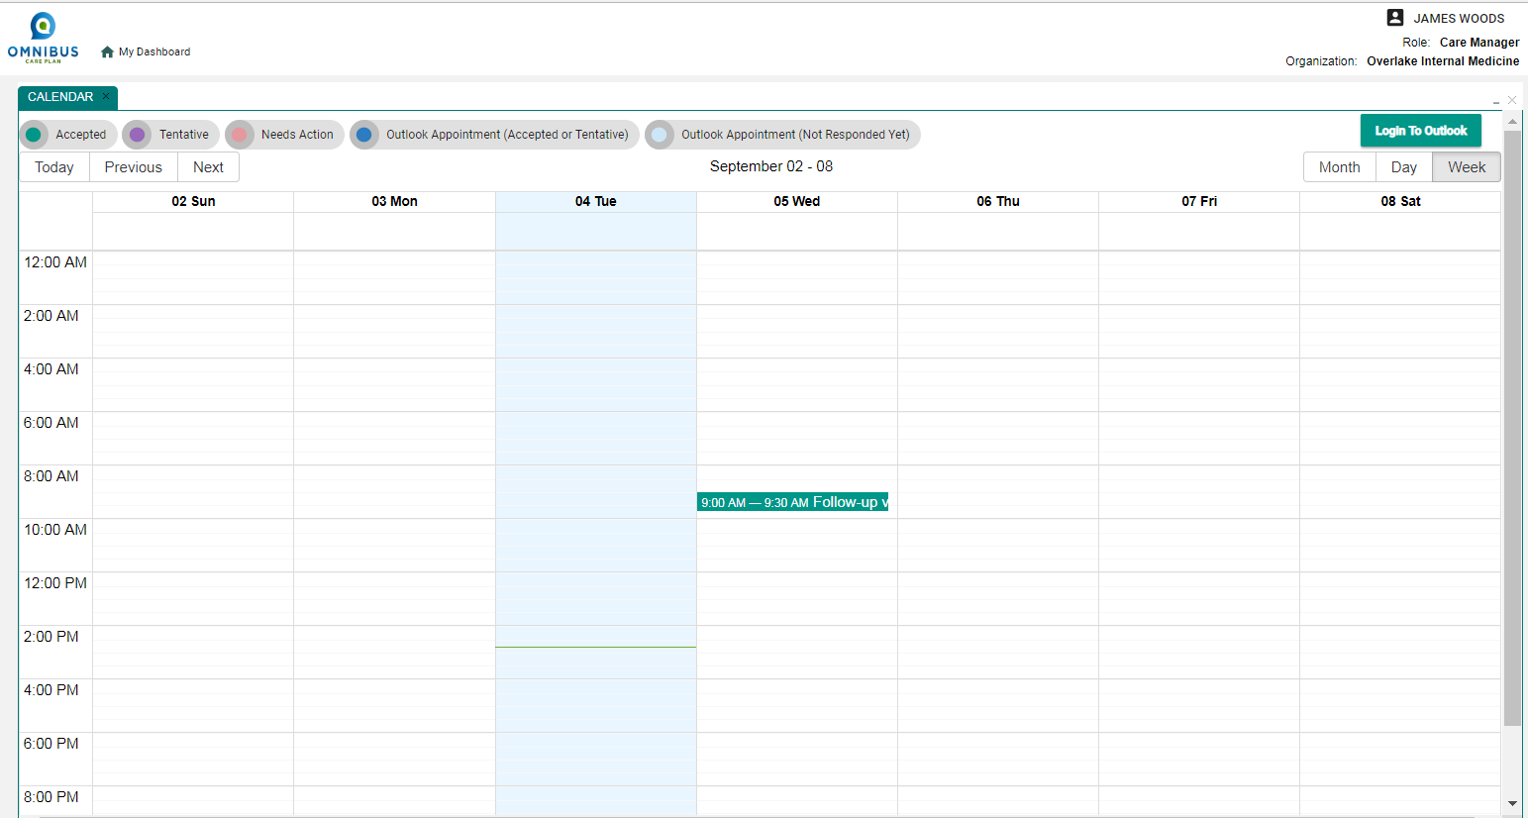
Appointment Displays on Care Manager’s Calendar

Slide 53
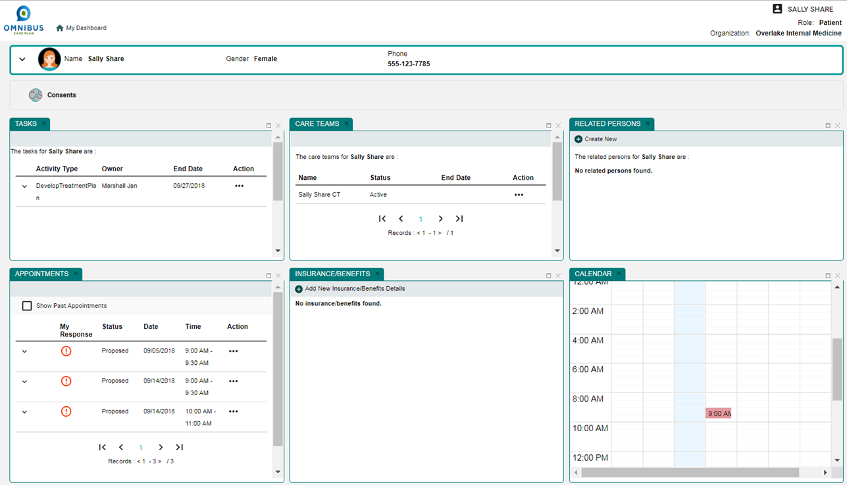
Patient Must Accept Appointment
The Care Manager has now proposed an appointment.
The patient must accept the proposed appointment.
The patient returns to her OCP dashboard (next slide).

Slide 54

Patient Dashboard

Slide 55
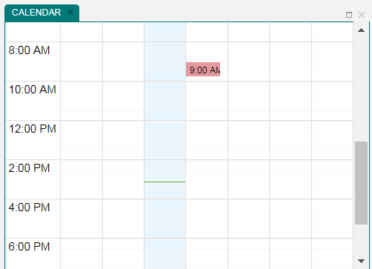
Patient Dashboard: Calendar
Patient can see proposed appointment on her calendar

Slide 56
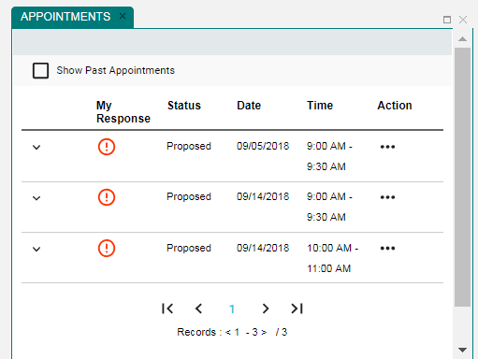
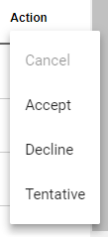
Patient Dashboard: Calendar
Patient can see proposed appointment on her Appointments panel.
The proposed appointment is in red as an alert.
The patient clicks the Action ellipses.
The patient sees the choices to Accept, Decline, or mark as Tentative.
She chooses the Accept option.

Slide 57
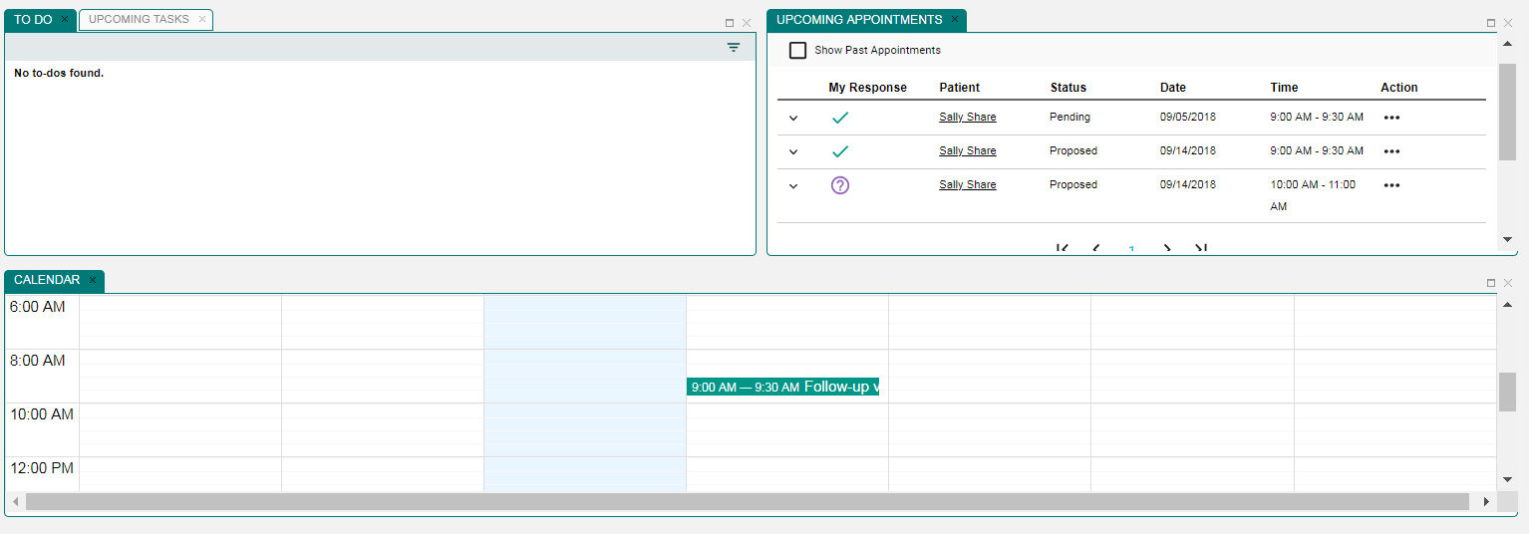
Care Manager Dashboard
The Care Manager can now see that the patient has accepted the appointment on the Upcoming Appointments panel and on the Calendar Panel.

Slide 58
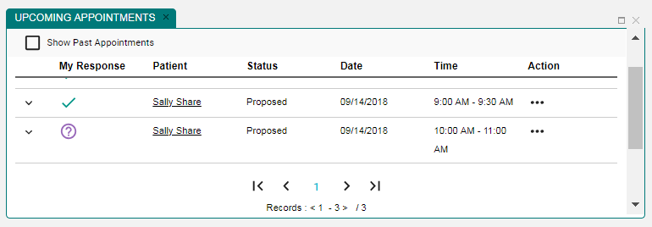
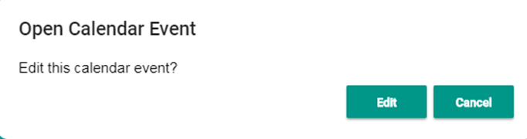
Care Manager Dashboard: Edit/Cancel Appointment
The Care Manager can edit or cancel the appointment by clicking on the appointment in the calendar or the Action ellipses in the Upcoming Appointments panel. If Edit is chosen, the Care Manager will be brought back to the Edit Appointment page.

Slide 59
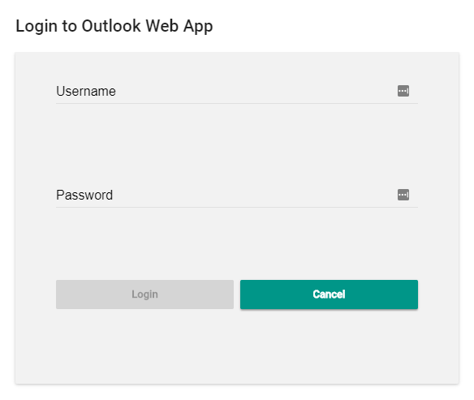
Calendar Panel: Login to Outlook
OCP calendar can be linked to Outlook.
Select Login to Outlook.
Enter Outlook Username and Password

Slide 60

Calendar Panel: Login to Outlook
OCP calendar can be linked to Outlook.
Select Login to Outlook.

Slide 61

Part 5: Managing the Patient’s Details Page

Slide 62
Patients Panel: Open Patient Card
First, click name for Patient Details Page.
The Patient Card opens. Click the Continue button.

Slide 63

Patients Panel: Patient’s Details Page
After clicking the Continue button, the Patient’s Details Page opens.

Slide 64

Patient’s Panels
There are five panels: Patient’s Tasks, Appointments, Care Teams, Communications, and Insurance/Benefits.

Slide 65

5.1: Managing the Patient’s Tasks/To Do Panel
Patient’s Tasks and Patient’s To Do tabs toggle.

Slide 66


Patient’s Tasks: Expand Patient Tasks Details
Clicking chevron opens Patients Tasks details.

Slide 67


Patient’s Tasks: Edit, Cancel, etc. Options
Click Action ellipses to open options.
1
2

Slide 68
Patient’s Tasks: Edit
After clicking Action ellipses, click Edit option

Slide 69

Patient’s Tasks: Update Main Task Page Opens

Slide 70
Patient’s Tasks: Add SubTask
After clicking Action ellipses, click Add SubTask option option

Slide 71

Patient’s Tasks: Add SubTask Page Opens
After clicking Action ellipses, click Add SubTask option option

Slide 72
Patient’s Tasks: Add Communication
After clicking Action ellipses, click Add Communication option

Slide 73

Patient’s Tasks: Add Communication Page Opens

Slide 74

Patient’s Tasks: Cancel
After clicking Action ellipses, click Cancel option

Slide 75

Patients Tasks: Add New Task
Click New Task icon to begin adding a new task

Slide 76
Patient’s Tasks: Update Main Task Page Opens

Slide 77

Patient’s To Do Panel
Click Patient’s To Do Tab.

Slide 78
Patient’s To Do Panel: Quick Look
Click chevron for To Do details

Slide 79

Patient’s To Do Panel: Edit or Cancel
Click ellipses to Edit or Cancel.

Slide 80


Patient’s To Do Panel: Edit Sub Task Page
Click Edit option. Edit Sub Task page opens.

Slide 81
Patient’s To Do Panel: Edit Sub Task Page

Slide 82



The To Do Panel Search Filter
Click Filter icon.
Select date range to filter.
Provides options from 1 day to All.

Slide 83

5.2: Managing Patient’s Care Teams Panel

Slide 84

Patient’s Care Teams: Edit Care Team
To edit existing Care Team, click Action ellipses

Slide 85

Patient’s Care Teams: Edit Care Team Page Opens

Slide 86

Patient’s Care Teams: Edit Category

Slide 87

Patient’s Care Teams: Edit Status

Slide 88

Patient’s Care Teams: Edit Reason

Slide 89

Patient’s Care Teams: Edit Start/Stop Dates

Slide 90

Patient’s Care Teams: Add Participant

Slide 91


Patient’s Care Teams: Search for Participant
Enter first three letters of name, select member type, click search, results appear.

Slide 92
Patient’s Care Teams: Search for Participant
Select Role, Start and End Dates, click Add button.

Slide 93

Patient’s Care Teams: Select Role
Select Role

Slide 94


Patient’s Care Teams: Select Dates
Select Role, Start and End Dates, click OK, and click Add button.

Slide 95

Patient’s Care Teams: Delete Participant
To delete a participant from the Care Team, click the Remove button and save.

Slide 96
Create New Care Team
To create new Care Team, click Create New icon.

Slide 97

Create Care Team Page Opens
Add required information and select Add Participant button.

Slide 98

5.3: Manage Patient’s Appointments
The Care Coordinator can view and manage patient’s appointments.

Slide 99

Manage Appointments: View Details
Click chevron to view appointment details.

Slide 100

Manage Appointments: Modify
Click Action ellipses to Add Communication, Edit, or Cancel

Slide 101

Manage Appointments: Add Communication
Click Add Communication

Slide 102


Manage Appointments: Complete Status
Can choose Reason and Contact Method
Can create message
Can write note

Slide 103


Manage Appointments: Edit Status
Click Status

Slide 104

Manage Appointments: Edit Status
Click Add Participant and Add Participant option opens.
Complete required fields

Slide 105

Manage Appointments: Cancel Appointment
Click Cancel and appointment is canceled. Status changes to Canceled.

Slide 106

5.4: Managing Patient’s Communications
Care Coordinator can manage patient’s communications.

Slide 107

Manage Patient’s Communications: Review
Click chevron to review a communication.

Slide 108

Manage Patient’s Communications: Edit
Click ellipses to edit chevron to review a communication.

Slide 109




Manage Patient’s Communications: Edit Options
X
Options for Status and Reason.

Slide 110

Manage Patient’s Communications: Add Recipient
Enter new recipient name
Enter Member Type and required fields
Click the Add button

Slide 111


Add Related Communications
To add a related communication, first click the ellipses.
Select Add Communication.

Slide 112

Add New Communication Page Opens
Enter information in fields
Click Save button

Slide 113


View Appointment Related Communications
Click any row in Appointments panel Panel in Patient’s details page
Works same when clicked on any row in Tasks and To-Do panel

Slide 114

Part 6: Manage Patient’s Coverage
Care Coordinators can manage patient’s coverage

Slide 115

Manage Patient’s Coverage: View Details
Click chevron to view details

Slide 116
Manage Patient’s Coverage: View Details
Click chevron to view details

Slide 117


Manage Patient’s Coverage: Add New Coverage
Click New Coverage icon

Slide 118

Manage Patient’s Coverage: Add New Coverage
Enter required information and click the Save button.

Slide 119



Manage Patient’s Coverage: Edit Options
Required information for Relationship, Coverage Type, and Status.

Slide 120


Part 7: Viewing and Creating Consents
Care Coordinators can View and Create Patient Consents
First click patient name. Patient Card opens. Click Continue Button.

Slide 121


Consents: Viewing Consents
Click Consents, Patient Consents Page opens

Slide 122
Consents: View Consents
STAN: Would be nice to have a grab of existing consents here

Slide 123
Consents: Add New Consent
Click Add New Consent button

Slide 124

Consents: Patient Consent Page Opens

Slide 125
Consents: Creating Consent for Patient
Select Care Teams
Select Medical Information
Select Purpose of Use
Select Consent Terms

Slide 126

Consents: Edit Disclose Information To
Click And Disclose My Information To Button.

Slide 127


Consents: Select “To” Actors
Click Disclose My Information To Button
Select “To” Actors page opens
Select Organizations and Practitioners
Click Confirm Button

Slide 128

Consents: “To” and “From” Actors Populate

Slide 129
Consents: Edit Purpose of Use

Slide 130


Consents: Edit Purpose of Use
Click Edit Button
Sharing options pop-up opens.

Slide 131



Consents: Edit Dates
Select Consent Start Date
Select Consent End Date
Calendars open

Slide 132

Consents: Select Make Available to Entire Care Team
There is an option to share health data with the patient’s entire Care Team

Slide 133

Consents: Select Make Available to Entire Care Team
One selected, the page opens like this

